Slide 1

Web Portals
Gateway To Information
Or A Hole In Our Perimeter Defenses
sm
Deral Heiland – Layered Defense Research

Slide 2

Speaker Bio
Deral Heiland
Employed as Senior Information Security Analyst by a fortune 500 company,
Founder of Layered Defense Research
&
Co-founder of Ohio Information Security Forum
Threat ,Vulnerability & Risk specialist
I have a passion for security
I Love sharing security with others
Believe the greatest weapon in the hands of security professional is knowledge

Slide 3
Getting Started
This presentation is only the starting point
Describe a vulnerability discovered while security testing a portal system
Describe several follow up test performed to better measure the impact of the vulnerability
Only had limited access so much more research needs done ( No access to vulnerable code)
At this point there may be more questions than answers

Slide 4
Presentation Agenda
Outline of portal technology
What risk are potentially created by portals
The initial discovery of the vulnerability
Expanded testing of the vulnerability
Next phase of this project and where it may lead
Other security methodologies that may protect us from this vulnerability being exploited

Slide 5
Web Portal Technology

Slide 6
Web Portals
Started in the late 90’s
Single point of access
Key types of portals
  Corporate Enterprise
  Consumer based
  Personal/Mobil

Slide 7
Web Portals
Technology has grown
  From simple web links to information resources
  To a technology that aggregates the information from a multitude of sources and delivers the requested info as if it was stored at that point
Notes:
Story on portal demo of large portal

Slide 8
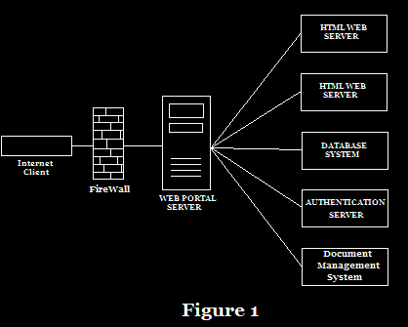
Web Portals

Slide 9
Web Portals
User Interface modules
    Portlet, Gadget, Applets, Connector
    JSR168 Java Portlet Specification
      Defines a common Portlet API and infrastructure
      Portability

Slide 10
Portal Security Concerns

Slide 11
Security Concerns
Portal suffer from the standard list of web vulnerabilities
    SQL injection
    XSS
    Remote file inclusion RFI
    Insecure Direct Object Referencing
What makes the web portal so great may also make it a security liability
    A gateway to functions and services.
    Aggregating key data from multiple sources
Notes:
With the portals being a single aggregation point for key data ,function and services, also makes it a potential security liability . The reason being that these services where once only available by internal users now are being publishing to the internet at a single point of access. Any security breakdowns at this point could lead us to loosing the keys to our kingdom.

Slide 12
Security Concerns
More than just a Web server. But a web server with access to.
    Document management
    Knowledge management
    Business intelligence
    ERP
    Payroll
    Expense reporting system
    Other web server content
Notes:
One of the key pieces of the portal server are the user interface modules (portlets). The portlet can be designed to deliver to the user the requested information that the user can not directly access. The portlet carries out there transaction as a server side function.
These portlest makes this more than just web server. But make this single point of access to internal resources.

Slide 13
Vulnerability Discovery

Slide 14
Vulnerability Discovery
Security testing web site
  Discovered several XSS vulnerabilities
    Replace the news story in the users browser or execute script in the users browser
    This looked like any standard XSS vulnerability

Slide 15
Vulnerability Discovery
https://AcmeWedgits.com/portal?NewHeadline=true&nodeTitle=AcmeWedgits%20News&news_link=%2fnews%2fPortal%2fAcmeWedgitsFirstQuarterEarnings
Point the news_link= to your web site and you have a simple XSS “but is it”

Slide 16
Vulnerability Discovery
At first this was documented as a simple XSS
Double checked our findings.
  Realized it was In the portlet
  Is this a server side vulnerability?
  Could this lead to deeper compromise of the system ?

Slide 17
Vulnerability Discovery
https://AcmeWedgits.com/portal?NewHeadline=true&nodeTitle=AcmeWedgits%20News&news_link=http://www.layereddefense.com/index.html
Wireshark sniffer on client
Web logs on layereddefense.com

Slide 18
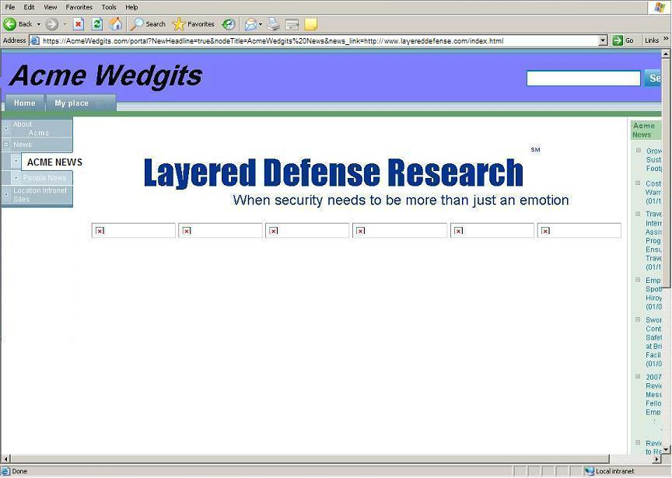

Slide 19
Vulnerability Discovery
Sniffer trace showed no traffic between client and layereddefense.com
All sniffer traffic was between client and Acme Wedgit
Layereddefense.com logs logged connection from Acme Wedgit only

Slide 20
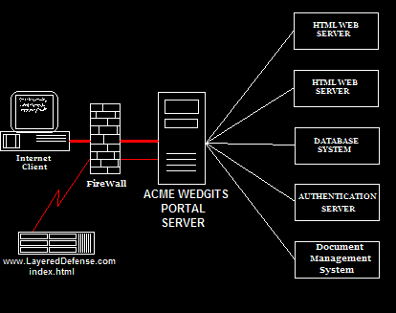
Vulnerability Discovery

Slide 21
Vulnerability Discovery
This not a standard XSS
    XSS are client side attacks
    This vulnerability is on Server Side
      Vulnerable portlet
      Our request are be proxied by the portal server
    Appears to have some of the aspects of CSRF
      CSRF is an attack exploiting the trusted rights of a client
      Here we are utilizing the trust of the server
    More of a Server Side Request Forgery (SSRF)

Slide 22
Exploiting Vulnerability
what else can we do

Slide 23
Exploiting Vulnerability
Now we know this is a server side vulnerability
  Gain access to internal resource
    Printers
    Other web servers
    Management consoles

Slide 24
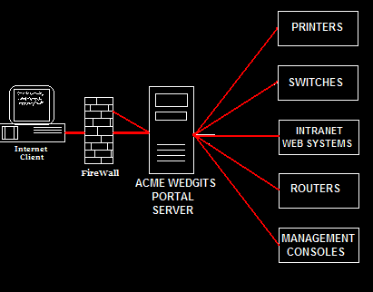
Exploiting Vulnerability

Slide 25
Exploiting Vulnerability
https://AcmeWedgits.com/portal?NewHeadline=true&nodeTitle=AcmeWedgits%20News&news_link=http://192.168.15.35/tcp_param.htm
https://AcmeWedgits.com/portal?NewHeadline=true&nodeTitle=AcmeWedgits%20News&news_link=http://192.168.15.35/hp/device/this.LCDispatcher%3fnav%3dhp.ConfigDevice%26menu%3d6%264b-dd4b-11e4-96-4d-0-10-83-be-45-99%3don%26btnApply%3dApply

Slide 26
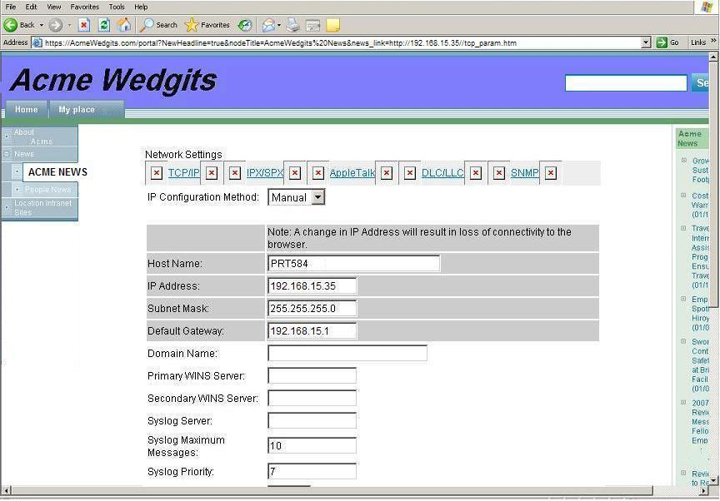

Slide 27
Functions & Limitations
Could access web resources running on any TCP port.
SSL would not work
Needed to point to a file name
  Index.html
  default.html
All data displayed as raw information

Slide 28
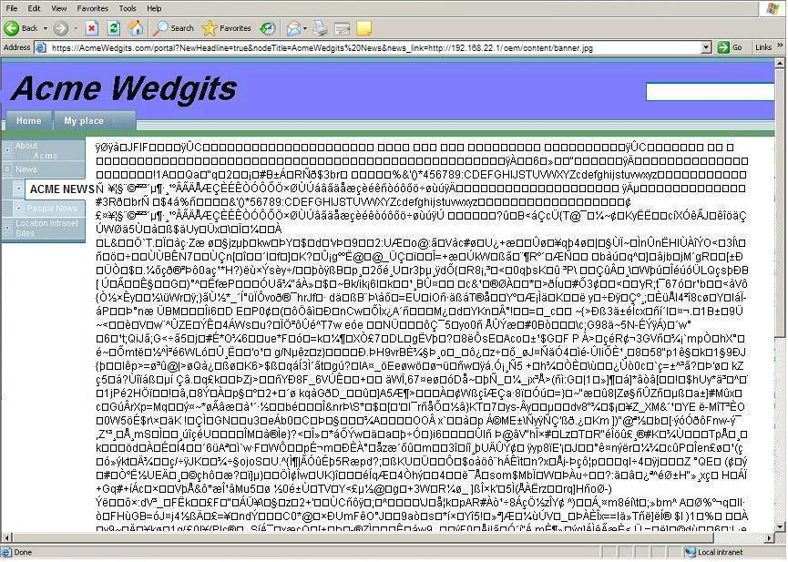

Slide 29
Exploiting Vulnerability
  Use vulnerability to recon the internal network
    Identifying internal systems by there web interface /index.html
      Alcatel switches and routers
      Juniper Netscreen
      HP Integrated Lights out
      Avaya PBX
      VOIP system management console
      Standard web servers

Slide 30
Exploiting Vulnerability
  Search for specific targets
    Printers, Copiers and Faxs
      HP, Ricoh, Sharps, Lexmark
    Managed UPS systems
    Storage Area Network devices
  Use vulnerability to proxy your attacks on external targets

Slide 31
Conclusion

Slide 32
Next phase of project
Determine whether this vulnerability was an isolated occurrence or a more common issue
Deeper dive into portlet coding standards
Testing of other portlets & portal systems
Get other experts involved

Slide 33
Final Note
Simple Vulnerabilities in a portal User interface modules “Portlet”.
    Compromised perimeter security
      Exploitation of internal web systems
      Reconnaissance of the Internal network
    Proxy attacks
    Server side attacks

Slide 34
The Obvious
Implementation of other security methods is advised
  Insure the portal server is in a DMZ
  Do not allow the portal server to initiate connections to the Internet.
  Only allow the portal server to make internal connections to authorized resources.
  Restrict portal connectivity only to ports needed.

Slide 35
Questions ?
Please Send question & Feedback
Deral Heiland
dh@LayeredDefense.com

